Slide 1
EMPLOYEE
MANAGEMENT SYSTEM
]

Slide 2
ABSTRACT
The Employee Management System is a graphical user interface application built using Python's Tkinter library. It provides functionalities for managing employee records efficiently. The system allows users to input and store employee details such as name, age, date of joining, email, gender, contact number, and address. Users can perform various operations like adding new employee details, updating existing records, deleting records, and clearing fields. The application offers a visually pleasing interface with a combination of text inputs, dropdown menus, and buttons for intuitive interaction. Additionally, it incorporates a tabular view using a Treeview widget to display employee records dynamically, enhancing usability and data visualization. This system simplifies employee data management tasks for organizations, improving productivity and organization within the workplace.

Slide 3
KEY FEATURES
DATABASE INTEGRATION
DATA VALIDATION
DATA DISPLAY
EASY CRUD
OPERATIONS
Supports CRUD (Create, Read, Update, Delete) operations for managing employee records. Users can add new records, update existing ones, delete records, and view all records.
The system
incorporates input validation to ensure that all required fields are filled and that the entered data is of the correct format.
Utilizes a tabular view to display employee records, making it easy for users to browse and locate specific information.
Integrates with a database (presumably SQLite in this case) to store and manage employee records persistently.

Slide 4
MODULES
User Interface Module:
Database Module:
This module, named main, is responsible for creating the graphical user interface (GUI) using the Tkinter library.
It defines the layout and appearance of the GUI elements, including labels, entry fields, buttons, and a table view.
Event handling functions for user interactions, such as adding, updating, and deleting employee records, are implemented within this module.，
This module, named db, encapsulates functionalities related to database operations using SQLite.
It provides a Database class that serves as an interface for performing CRUD operations on an SQLite database file.
Operations such as inserting new records, updating existing ones, deleting records, and fetching all records are defined within this module.

Slide 5
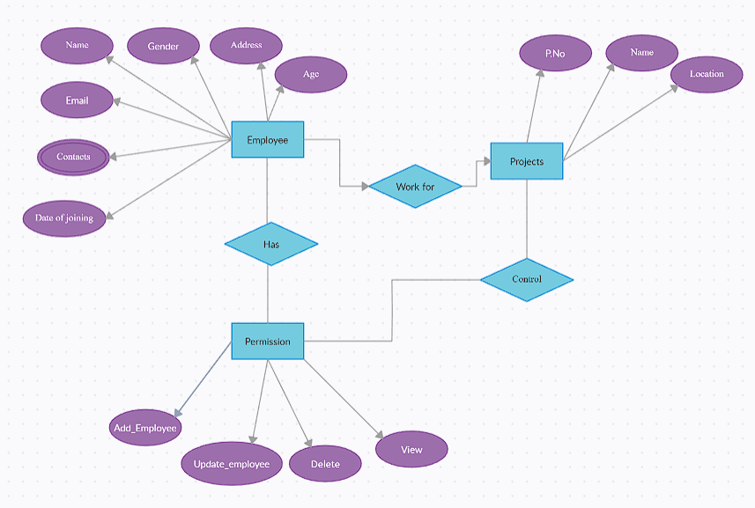
ER DIAGRAM
ENTER TITLE
Click here to add content of the text，and briefly explain your point of view.Click here to add content of the text，

Slide 6
SOURCE CODE
main.py
from tkinter import *
from tkinter import ttk
from tkinter import messagebox
from db import Database
db = Database("Employee.db")
root = Tk()
root.title("Employee Management System")
root.geometry("1920x1080+0+0")
root.config(bg="#2c3e50")
root.state("zoomed")
name = StringVar()
age = StringVar()
doj = StringVar()
gender = StringVar()
email = StringVar()
contact = StringVar()
\

Slide 7
# Entries Frame
entries_frame = Frame(root, bg="#2D3142")
entries_frame.pack(side=TOP, fill=X)
title = Label(entries_frame, text="Employee Management System", font=("Calibri", 18, "bold"), bg="#2D3142", fg="white")
title.grid(row=0, columnspan=2, padx=10, pady=20, sticky="w")
lblName = Label(entries_frame, text="Name", font=("calibri", 17,"bold"),bg='#2D3142', fg="white")
lblName.grid(row=1, column=0, padx=10, pady=10, sticky="w")
txtName = Entry(entries_frame, textvariable=name, font=("Calibri", 16), width=30)
txtName.grid(row=1, column=1, padx=10, pady=10, sticky="w")
lblAge = Label(entries_frame, text="Age", font=("calibri", 17,"bold"),bg='#2D3142', fg="white")
lblAge.grid(row=1, column=2, padx=10, pady=10, sticky="w")
txtAge = Entry(entries_frame, textvariable=age, font=("Calibri", 16), width=30)
txtAge.grid(row=1, column=3, padx=10, pady=10, sticky="w")
\

Slide 8
lbldoj = Label(entries_frame, text="D.O.J", font=("calibri", 17,"bold"),bg='#2D3142', fg="white")
lbldoj.grid(row=2, column=0, padx=10, pady=10, sticky="w")
txtDoj = Entry(entries_frame, textvariable=doj, font=("Calibri", 16), width=30)
txtDoj.grid(row=2, column=1, padx=10, pady=10, sticky="w")
lblEmail = Label(entries_frame, text="Email", font=("calibri", 17,"bold"),bg='#2D3142', fg="white")
lblEmail.grid(row=2, column=2, padx=10, pady=10, sticky="w")
txtEmail = Entry(entries_frame, textvariable=email, font=("Calibri", 16), width=30)
txtEmail.grid(row=2, column=3, padx=10, pady=10, sticky="w")
lblGender = Label(entries_frame, text="Gender", font=("calibri", 17,"bold"),bg='#2D3142', fg="white")
lblGender.grid(row=3, column=0, padx=10, pady=10, sticky="w")
comboGender = ttk.Combobox(entries_frame, font=("Calibri", 16), width=28, textvariable=gender, state="readonly")
comboGender['values'] = ("Male", "Female")
comboGender.grid(row=3, column=1, padx=10, sticky="w")
\

Slide 9
lblContact = Label(entries_frame, text="Contact No",font=("calibri", 17,"bold"),bg='#2D3142', fg="white")
lblContact.grid(row=3, column=2, padx=10, pady=10, sticky="w")
txtContact = Entry(entries_frame, textvariable=contact, font=("Calibri", 16), width=30)
txtContact.grid(row=3, column=3, padx=10, sticky="w")
lblAddress = Label(entries_frame, text="Address", font=("calibri", 17,"bold"),bg='#2D3142', fg="white")
lblAddress.grid(row=4, column=0, padx=10, pady=10, sticky="w")
txtAddress = Text(entries_frame, width=85, height=5, font=("Calibri", 16))
txtAddress.grid(row=5, column=0, columnspan=4, padx=10, sticky="w")
def getData(event):
selected_row = tv.focus()
data = tv.item(selected_row)
global row
row = data["values"]
#print(row)
name.set(row[1])
age.set(row[2])
doj.set(row[3])
email.set(row[4])
gender.set(row[5])
contact.set(row[6])
txtAddress.delete(1.0, END)
txtAddress.insert(END, row[7])
\

Slide 10
def dispalyAll():
tv.delete(*tv.get_children())
for row in db.fetch():
tv.insert("", END, values=row)
def add_employee():
if txtName.get() == "" or txtAge.get() == "" or txtDoj.get() == "" or txtEmail.get() == "" or comboGender.get() == "" or txtContact.get() == "" or txtAddress.get(
1.0, END) == "":
messagebox.showerror("Erorr in Input", "Please Fill All the Details")
return
db.insert(txtName.get(),txtAge.get(), txtDoj.get() , txtEmail.get() ,comboGender.get(), txtContact.get(), txtAddress.get(
1.0, END))
messagebox.showinfo("Success", "Record Inserted")
clearAll()
dispalyAll()
\

Slide 11
def update_employee():
if txtName.get() == "" or txtAge.get() == "" or txtDoj.get() == "" or txtEmail.get() == "" or comboGender.get() == "" or txtContact.get() == "" or txtAddress.get(
1.0, END) == "":
messagebox.showerror("Erorr in Input", "Please Fill All the Details")
return
db.update(row[0],txtName.get(), txtAge.get(), txtDoj.get(), txtEmail.get(), comboGender.get(), txtContact.get(),
txtAddress.get(
1.0, END))
messagebox.showinfo("Success", "Record Update")
clearAll()
dispalyAll()
def delete_employee():
db.remove(row[0])
clearAll()
dispalyAll()
\

Slide 12
def clearAll():
name.set("")
age.set("")
doj.set("")
gender.set("")
email.set("")
contact.set("")
txtAddress.delete(1.0, END)
btn_frame = Frame(entries_frame, bg='#2D3142')
btn_frame.grid(row=6, column=0, columnspan=4, padx=10, pady=10, sticky="w")
btnAdd = Button(btn_frame, command=add_employee, text="Add Details", width=15, font=("Calibri", 16, "bold"), fg="white",
bg='green', bd=0).grid(row=0, column=0,padx=10)
btnEdit = Button(btn_frame, command=update_employee, text="Update Details", width=15, font=("Calibri", 16, "bold"),
fg="white", bg="#2980b9",
bd=0).grid(row=0, column=1, padx=10)
btnDelete = Button(btn_frame, command=delete_employee, text="Delete Details", width=15, font=("Calibri", 16, "bold"),
fg="white", bg="#c0392b",
bd=0).grid(row=0, column=2, padx=10)
\

Slide 13
btnClear = Button(btn_frame, command=clearAll, text="Clear Details", width=15, font=("Calibri", 16, "bold"), fg="white",
bg="#f39c12",
bd=0).grid(row=0, column=3, padx=10)
# Table Frame
tree_frame = Frame(root, bg="#ecf0f1")
tree_frame.place(x=0, y=480, width=1980, height=520)
style = ttk.Style()
style.configure("mystyle.Treeview", font=('Calibri', 18),
rowheight=50) # Modify the font of the body
style.configure("mystyle.Treeview.Heading", font=('Calibri', 18)) # Modify the font of the headings
tv = ttk.Treeview(tree_frame, columns=(1, 2, 3, 4, 5, 6, 7, 8), style="mystyle.Treeview")
tv.heading("1", text="ID")
tv.column("1", width=5)
tv.heading("2", text="Name")
tv.heading("3", text="Age")
tv.column("3", width=5)
\

Slide 14
tv.heading("4", text="D.O.B")
tv.column("4", width=10)
tv.heading("5", text="Email")
tv.heading("6", text="Gender")
tv.column("6", width=10)
tv.heading("7", text="Contact")
tv.heading("8", text="Address")
tv['show'] = 'headings'
tv.bind("<ButtonRelease-1>", getData)
tv.pack(fill=X)
dispalyAll()
root.mainloop()
\

Slide 15
db.py
import sqlite3
class Database:
def __init__(self, db):
self.con = sqlite3.connect(db)
self.cur = self.con.cursor()
sql = """
CREATE TABLE IF NOT EXISTS employees(
id Integer Primary Key,
name text,
age text,
doj text,
email text,
gender text,
contact text,
address text
)
"""
self.cur.execute(sql)
self.con.commit()
\

Slide 16
# Insert Function
def insert(self, name, age, doj, email, gender, contact, address):
self.cur.execute("insert into employees values (NULL,?,?,?,?,?,?,?)",
(name, age, doj, email, gender, contact, address))
self.con.commit()
def fetch(self):
self.cur.execute("SELECT * from employees")
rows = self.cur.fetchall()
# print(rows)
return rows
# Delete a Record in DB
def remove(self, id):
self.cur.execute("delete from employees where id=?", (id,))
self.con.commit()
# Update a Record in DB
def update(self, id, name, age, doj, email, gender, contact, address):
self.cur.execute(
"update employees set name=?, age=?, doj=?, email=?, gender=?, contact=?, address=? where id=?",
(name, age, doj, email, gender, contact, address, id))
self.con.commit()
\

Slide 17
THANK YOU
\

